Slide 1
Class 2 – 29 Jan
Conditionals
Basic input
Variables

Slide 2
Previously in IMM120
Where is Professor Hallberg’s office?
Adjunct office: 3rd floor, right of the IMM office (top of the center stairs).
When are Professor Hallberg’s office hours?
All day Monday from 11am until class.
Email Address:
crhallberg@gmail.com
hallber2@tcnj.edu

Slide 5
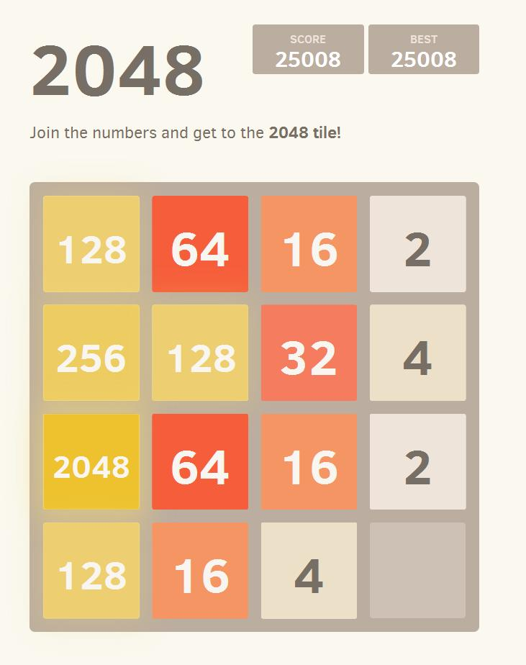

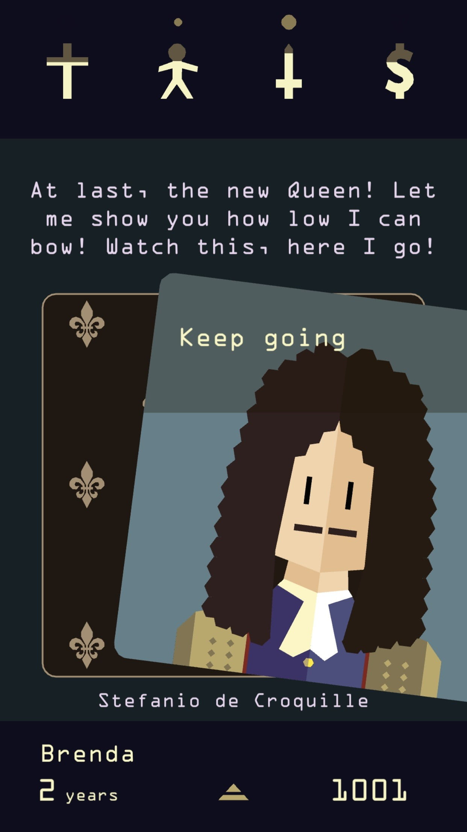
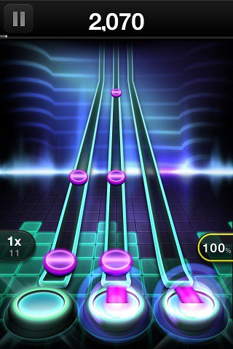


Slide 6
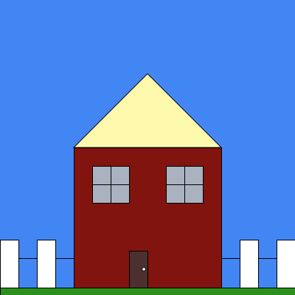
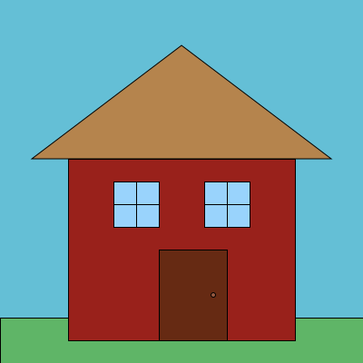
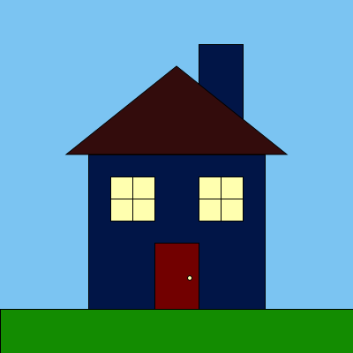
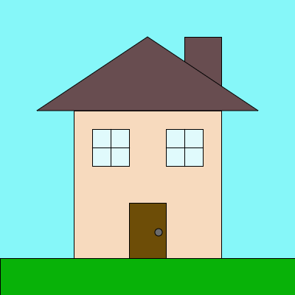
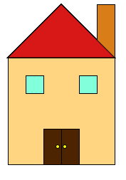
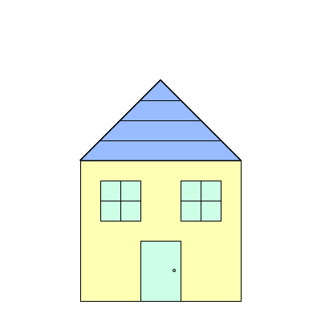
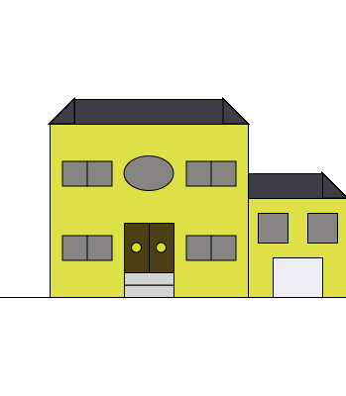
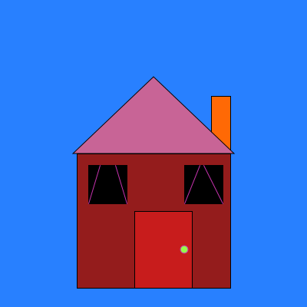
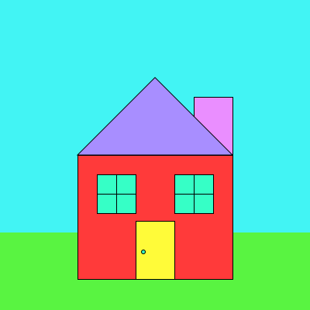


Slide 7
Anything else?
Questions, concerns, homework questions?

Slide 8
Today in IMM120
Words, words, words
Defusing a bomb
The Truth
Saving data in your project

Slide 9
Words, Words, Words

Slide 10
Three Ways to Display Words:
print(variable) – Print value to the console
text(“a”, x, y) – Display words on the canvas
alert(5) – Pop-up with information, pause code

Slide 11
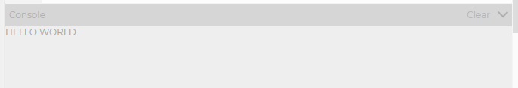
Three Ways to Display Words:
print(variable) – Print value to the console
text(“a”, x, y) – Display words on the canvas
alert(5) – Pop-up with information, pause code

Slide 12
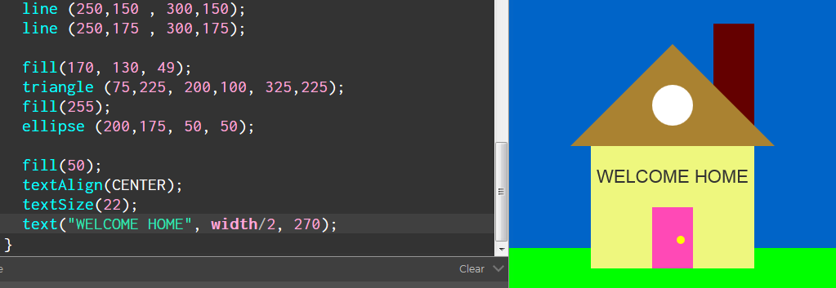
Three Ways to Display Words:
print(variable) – Print value to the console
text(“a”, x, y) – Display words on the canvas
alert(5) – Pop-up with information, pause code

Slide 13
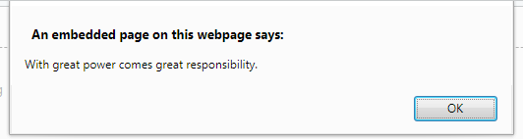
Three Ways to Display Words:
print(variable) – Print value to the console
text(“a”, x, y) – Display words on the canvas
alert(5) – Pop-up with information, pause code

Slide 14
Debugging Tips
How to fix “bugs”.

Slide 15
Syntax vs Semantics
Yes, I ate the last slice, and I’m proud!
Yes/ I ate the last’ slice. And? Im rpoud:
Yes, I ate the last slice, or I’m proud!

Slide 16
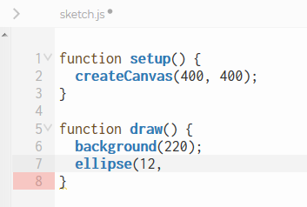
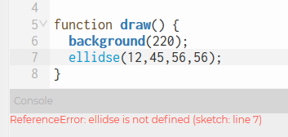
p5.js’s Helpers

Slide 17
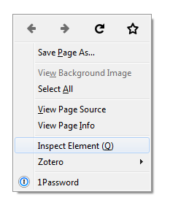
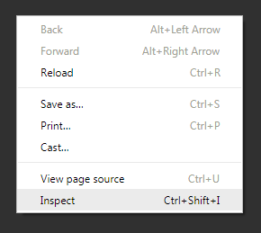
Browser Console

Slide 18
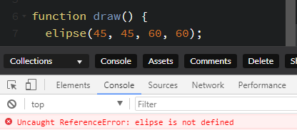

Browser Console

Slide 19
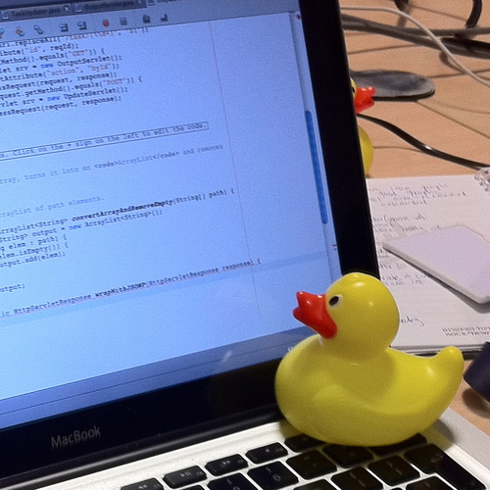
The Rubber Duck Method
Notes:
The rubber duck debugging method is as follows:
Beg, borrow, steal, buy, fabricate or otherwise obtain a rubber duck (bathtub variety).
Place rubber duck on desk and inform it you are just going to go over some code with it, if that’s all right.
Explain to the duck what your code is supposed to do, and then go into detail and explain your code line by line.
At some point you will tell the duck what you are doing next and then realize that that is not in fact what you are actually doing. The duck will sit there serenely, happy in the knowledge that it has helped you on your way.
Note: In a pinch a coworker might be able to substitute for the duck, however, it is often preferred to confide mistakes to the duck instead of your coworker.

Slide 20
Rubber Duck Debugging - FAQ
If ducks are so smart, why don’t we just let the ducks do all the work?
It would be wonderful if this were true, but the fact is that most ducks prefer to take a mentoring role. There are a few ducks however that do choose to code, but these are the ducks that nobody hears about because they are selected for secret government projects that are highly classified in nature.
Where can I learn more about rubber duck debugging?
More information can be found at rubberduckdebugging.com, wikipedia.org, lists.ethernal.org, and zenhub.com.
Where can I hire my own duck?
Great question! Amazon.com hosts a wide selection of affordable ducks that have graduated with a technical degree from some of the world’s leading universities.

Slide 21
Is That A Bomb????
Please go to bombmanual.com. Trust me. It’s fine.
Page 5.
Shout out to Keep Talking And Nobody Explodes

Slide 22
4. Conditionals

Slide 23
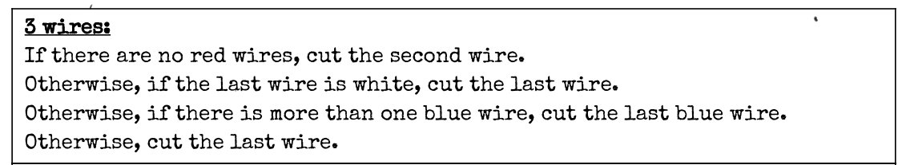
Conditionals In English

Slide 24
Conditionals In English
"If you see a bear, run!"
"If you're going to be late, give me a call."

Slide 25
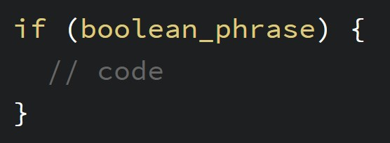
Conditionals in Code

Slide 26
The Truth
Computers can only deal with true and false (binary).
When we ask questions of computer they must be true or false questions.
The way we will guarantee that our questions are always true or false is by using comparisons for all of them.

Slide 27
Comparisons
There are four basic comparisons:
Greater than
Less than
Equal to
Not equal to

Slide 28

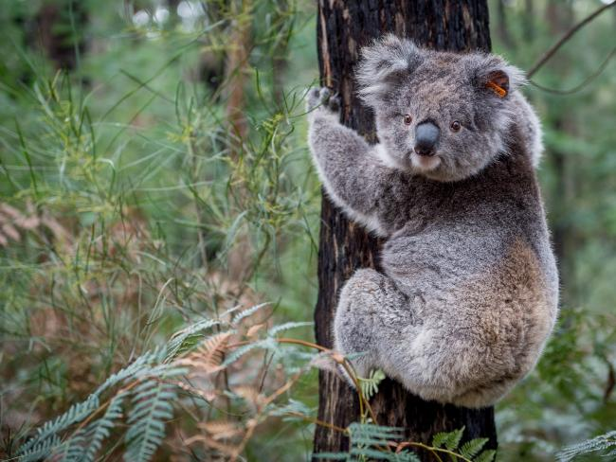
Comparison Koalas (Greater Than)
>

Slide 29
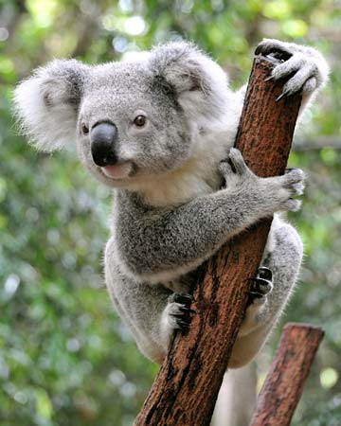

Comparison Koalas (Less Than)
<

Slide 30
Comparison Koalas (Equal To)
==

Slide 31
Comparison Koalas (Not Equal To)
!=

Slide 32
Boolean Operators
< | Less than | True: 4 < 5 False: 100 < 0
> | Greater than | True: 15 > 7 False: -1 > 1
== | Equal to | True: 4 == 4 False: 4 == 3
!= | Not equal to | True: 3.14 != 3 False: 1 != 1
!() | Not operator | True: !(False) False: !(True)

Slide 33
Numbers that Change
Using a label instead of a number
A label that represents the same value, but that value can change at any time
We call these variables

Slide 34
p5.js Numbers That Change
width and height
mouseX will always be the horizontal position of the cursor
Number of pixels between the cursor and the left edge
mouseY is the vertical position of the cursor
Number of pixels between the cursor and the top edge

Slide 35
Random Numbers
random() - random decimal between 0 and 1 (good for percents)
random(max) - random number between 0 and max
random(min, max) - random number between min and max

Slide 36
https://pastebin.com/CC8L9STu

Slide 37
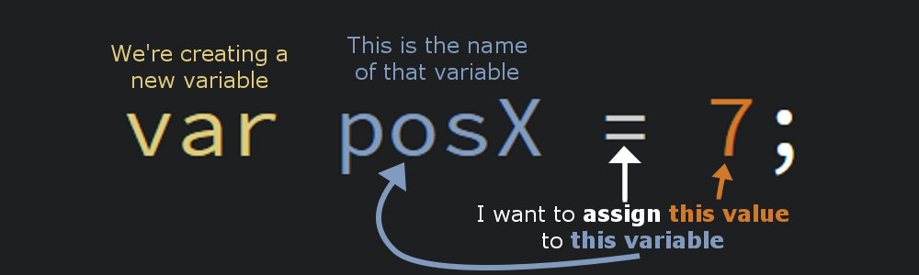
Making Your Own Variables

Slide 38
Naming Variables
There are only a few rules to naming variables:
They cannot contain spaces.
They cannot start with a number.
They cannot be named the same as anything else
Other variables, functions (draw, setup), etc.

Slide 39
Camel Case
allWorkAndNoPlayMakesJackADullBoy

Slide 40
Manipulating Variables
count = count + 1;
powersOfTwo = powersOfTwo * 2;
me = “Chris”;

Slide 41
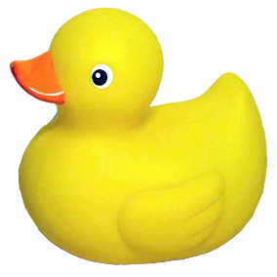
Try: Counting Random Numbers

Slide 42
Basic Input and Drawing
mouseIsPressed
keyIsPressed
key, keyCode

Slide 43
Things You Can Save

Slide 44
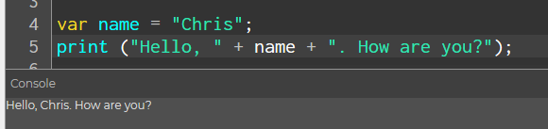
Strings
“These are words you can save”
“You can add ” + “them together too”

Slide 45
Objects
Objects allow you to save all the different parts of an object in one place.
For example, you can save the position and dimensions of a rectangle to a single variable.

Slide 46
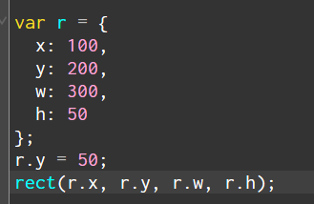
Rectangle Object

Slide 47
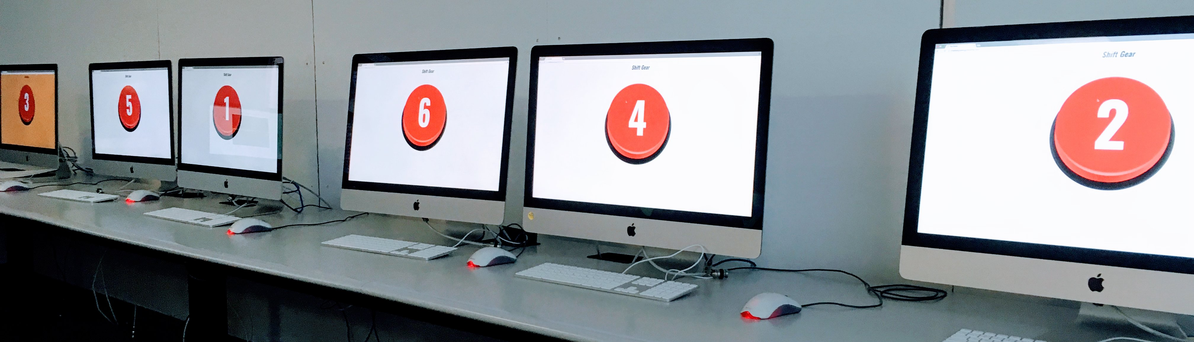
Global Game Jam 2018

Slide 48
Homework
Make sure you understand variables and conditionals.
YouTube: “Daniel Shiffman conditionals/variables”.
Look for the p5.js videos.
Come with questions next week.

Slide 49
Minute Survey
You have survived Week 2.

